Slide 1
SNAKE AI USING REINFORCEMENT LEARNING
INTRODUCTION TO ARTIFICIAL INTELLIGENCE
TEAM MEMBERS:
SAIDHEERAJ KONDI
DEEPTHI BOJANAPU

Slide 2
OBJECTIVES:
The main objective is to create a snake agent using reinforcement learning technique which can able to play snake game itself by learning and updating itself every time.
And another objective is to start the game with a single dot and increase the snake's size by collecting more dots.
Move the snake one dot at a time in any of the three directions (left, right, or straight).
Terminate the game when the snake collides with its own body or the edge of the environment.

Slide 3
APPROACH:
Develop a snake game environment: We will develop a snake game environment in Python using the PyTorch and Pygame library . The environment will provide the snake AI agent with the game state and allow it to take actions.
Implement reinforcement learning algorithms: We will implement the following reinforcement learning algorithms in Python using the PyTorch library:
Q-learning
Deep Q-learning
Train the snake AI agent: We will train the snake AI agent using the implemented reinforcement learning algorithms. The agent will learn to play the snake game by trial and error.
Q(s,a)←r+γ⋅max(Q(s′,a′))
Evaluate the trained snake AI agent: We will evaluate the performance of the trained snake AI agent on a variety of snake game levels.

Slide 4
DELIVERABLES:
The project will be submitted as a GitHub repository containing the following files:
Snake game environment code
Reinforcement learning algorithm code
Trained snake AI agent code
Evaluation report

Slide 5
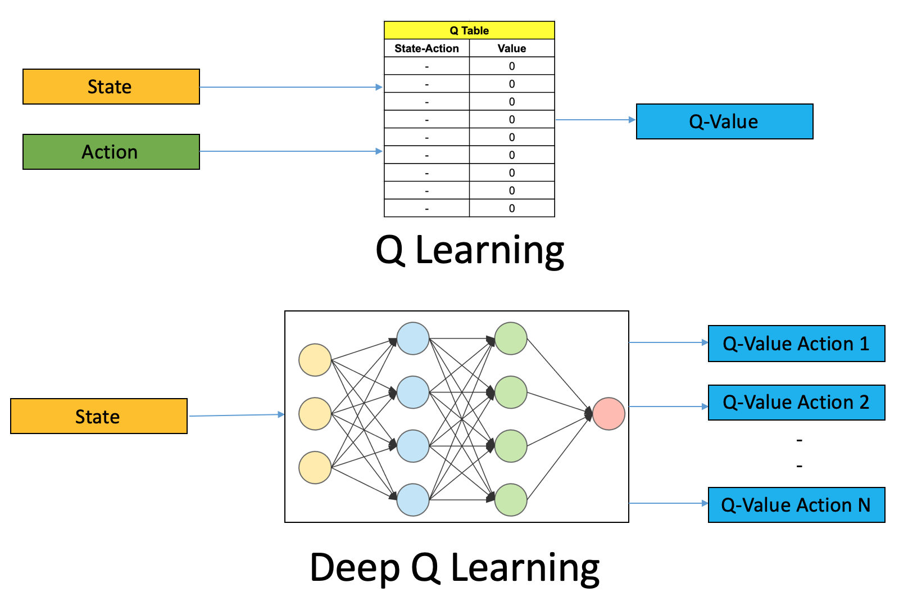
EVALUATION METHODOLOGY:
The snake game environment will be evaluated by ensuring that it provides the snake AI agent with the correct game state and allows it to take valid actions.
The reinforcement learning algorithms will be evaluated by ensuring that they are able to train the snake AI agent to play the snake game effectively.
The trained snake AI agent will be evaluated by measuring its performance on a variety of snake game levels.
If the trained snake AI agent is able to achieve high scores and survive for many games on a variety of snake game levels, then the project objectives will be considered to have been achieved.

Slide 6
Thank you

